Slide 1
INTRODUCTION TO ARTIFICIAL INTELLIGENCE
AISC/DS JAGLI
1
*
Module 1

Slide 2
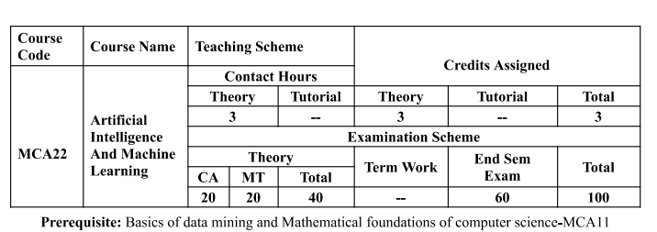
Course Structure

Slide 3
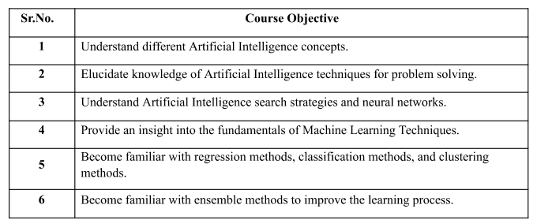
Course Objectives (CO):
3
*

Slide 4
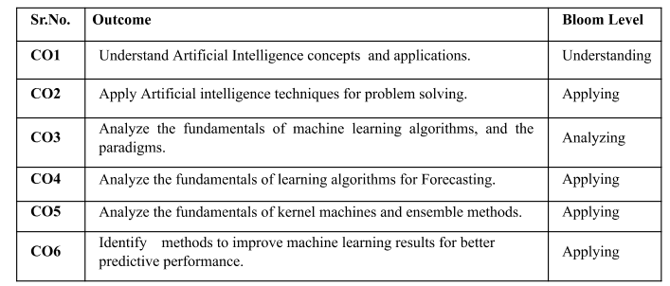
Course Outcomes (CO):
4
*

Slide 5
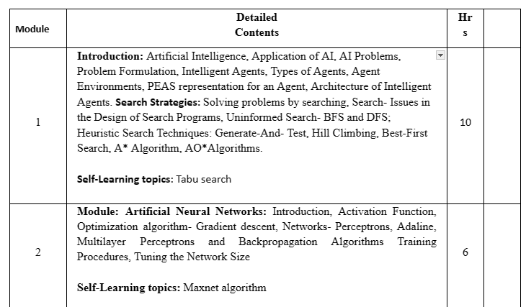
Syllabus

Slide 6
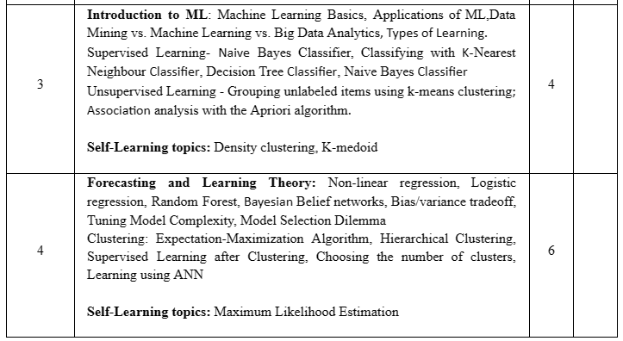
Syllabus

Slide 7
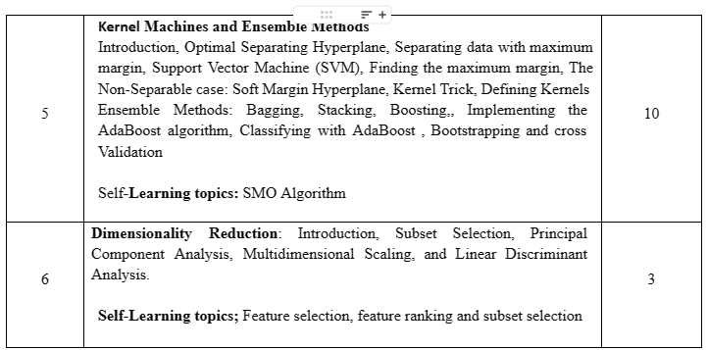
Syllabus

Slide 8
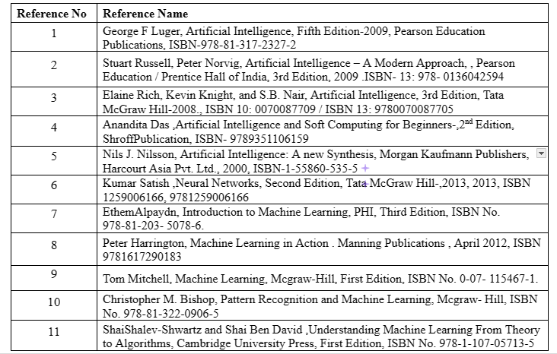
References

Slide 9
Grading
9
Internal Assessment:
Assessment consists of one Mid Term Test of 20 marks and Continuous Assessment of 20 marks.
Mid Term test is to be conducted when approx. 50% syllabus is completed Duration of the midterm test shall be one hour.
Continuous Assessment:-
Continuous Assessment is of 20 marks. The rubrics for assessment will be considered on approval by the subject teachers. The rubrics can be any 2 or max 4 of the following:-
*

Slide 10
Grading
10
Sr.no | Rubrics | Marks
1. | *Certificate course for 4 weeks or more:- NPTEL/ Coursera/ Udemy/any MOOC | 10 marks
2. | Wins in the event/competition/hackathon | 10 marks
3. | Content beyond syllabus presentation | 10 marks
4. | Creating Proof of concept | 10 marks
5. | Mini Project / Extra Experiments/ Virtual Lab | 10 marks
6. | Assignment/Tutorials Based on Syllabus | 10 marks
7. | Participation in event/workshop/talk / competition followed by small report and certificate of participation relevant to the subject(in other institutes) | 5 marks
8. | Multiple Choice Questions (Quiz) | 5 marks
*

Slide 11
Outline of Contents –Module 1
Introduction:
Artificial Intelligence,
Application of AI, AI Problems,
Problem Formulation, Intelligent Agents,
Types of Agents, Agent Environments, PEAS representation for an Agent,
Architecture of Intelligent Agents.
Search Strategies:
Solving problems by searching,
Search- Issues in the Design of Search Programs,
Uninformed Search- BFS and DFS;
Heuristic Search Techniques: Generate-And- Test, Hill Climbing, Best-First Search, A* Algorithm, AO*Algorithms.

Slide 12
Module Mapping With Text Books
12
1 Introduction to AI (Book I & II)
2 Problem Solving (Book I)
3 Knowledge Representation (Book I)
4 Concepts of Soft Computing (Book III)
5 Neural Network (Book III)
6 Fuzzy Logic Introduction to Fuzzy Logic, Classical Sets and Fuzzy (Book VI)
7 Fuzzy Inference System (Book III & VI)
8 Genetic Algorithm (Book III &IV)
*

Slide 13
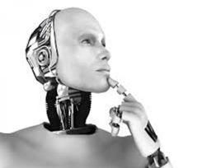
What is Artificial Intelligence?
13
AI as anything that makes machines act more intelligently.
A scientific and engineering discipline devoted to: understanding principles that make intelligent behavior possible in natural or artificial systems;
Developing methods for the design and implementation of useful, intelligent artifacts. [Poole, mackworth, goebel].
AI should not attempt to replace human experts, but rather extend human capabilities and accomplish tasks that neither humans nor machines could do on their own.
*

Slide 14
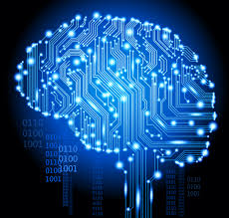
What is intelligence then?
14
Fast thinking?
Knowledge?
Ability to pass as a human?
Ability to reason logically?
Ability to learn?
Ability to perceive and act upon one’s environment?
Ability to play chess at grand-master’s level?
. . .
*

Slide 15
Acting Humanly
15
Can machines think?” −→ “Can machines behave intelligently?”
Operational test for intelligent behavior: the imitation game.
Predicted that by 2000, a machine might have a 30% chance of fooling a lay person for 5 minutes .
Anticipated all major arguments against AI in following 50 years.
Suggested major components of AI: knowledge, reasoning, language understanding, learning problem
*

Slide 16
AI Definitions
16
The study of mental faculties through the use
of computational models.
Charniak and McDermott, 1985
A field of study that seeks to explain and
emulate intelligent behavior in terms of
computational processes.
Schalkoff, 1990
The study of how to make computers do things at which, at the moment, people are better
Rich & Knight, 1991
*

Slide 17
AI Definitions
17
We call programs intelligent if they exhibit behaviors that would be regarded intelligent if they were exhibited by human beings.
---Herbert Simon
Physicists ask what kind of place this universe is and seek to characterize its behavior systematically. Biologists ask what it means for a physical system to be living . We in AI wonder what kind of information-processing system can ask such questions.
---Avron Barr and Edward Feigenbaum
AI is the study of techniques for solving exponentially hard problems in polynomial time by exploiting knowledge about the problem domain.
----Elaine Rich
*

Slide 18
Thinking Humanly: Cognitive Science
18
1960s “cognitive revolution”: information-processing psychology replaced prevailing orthodoxy of behaviorism.
Require scientific theories of internal activities of the brain
What level of abstraction? “Knowledge” or “circuits”?
How to validate? It requires
1. Predicting and testing behavior of human subjects (top-down, Cognitive Science)
2. Direct identification from neurological data (bottom-up, Cognitive Neuroscience)
*

Slide 19
Thinking Rationally: Laws of Thought
19
Several Greek schools at the time of Aristotle developed various forms of logic:
Notation and rules of derivation for thoughts. They may or may not have proceeded to the idea of mechanization
Direct line through mathematics and philosophy to modern AI
Problems:
1. Not all intelligent behavior is mediated by logical deliberation
2. What is the purpose of thinking? What thoughts should I have?
*

Slide 20
Acting Rationally
20
Rational behavior: doing the right thing, that which is expected to maximize goal achievement, given the available information
Doesn’t necessarily involve thinking—e.g., blinking reflex—but thinking should be in the service of rational action
Aristotle: Every art and every inquiry, and similarly every action and pursuit, is thought to aim at some good
*

Slide 21
Operational Definition of AI
21
Systems that act like humans
Turing test.
Systems that think like humans
Cognitive Science
Systems that think rationally
Logic-based AI
Systems that act rationally
Rational Agents
*

Slide 22
Artificial Intelligence (AI)
22
Artificial Intelligence (AI) is usually defined as the science of making computers do things that require intelligence when done by humans.
A.I is the study of ideas that enable computers to be intelligent.
The collective attributes of a computer, robot, or other device capable of performing functions such as learning, decision making, or other intelligent human behaviors.
*

Slide 23
Types of AI
Based on strength, breadth, and application, AI can be described in different ways.
Weak or Narrow AI is AI that is applied to a specific domain.
For example: language translators, virtual assistants, self-driving cars, AI-powered web searches, recommendation engines, and intelligent spam filters.
Applied AI can perform specific tasks, but not learn new ones, making decisions based on programmed algorithms, and training data.

Slide 24
Types of AI
Strong AI or Generalized AI is AI that can interact and operate a wide variety of independent and unrelated tasks.
It can learn new tasks to solve new problems, and it does this by teaching itself new strategies.
Generalized Intelligence is the combination of many AI strategies that learn from experience and can perform at a human level of intelligence.
Super AI or Conscious AI is AI with human-level consciousness, which would require it to be self-aware.
Because we are not yet able to adequately define what consciousness is, it is unlikely that we will be able to create a conscious AI in the near future.

Slide 25
Motivation
25
Why Artificial Intelligence?
Computers are fundamentally well suited to performing mechanical computations.
Artificial machines perform simple monotonous tasks efficiently and reliably
For more complex problems, things get more difficult... Unlike humans, computers have trouble understanding specific situations, and adapting to new situations.
Artificial Intelligence aims to improve machine behavior in tackling such complex tasks.
*

Slide 26
Motivation
26
Humans have an interesting approach to problem-solving, based on abstract thought, high-level deliberative reasoning and pattern recognition.
AI research is allowing us to understand our intelligent behavior.
Artificial Intelligence can help us understand this process by recreating it, then potentially enabling us to enhance it beyond our current capabilities.
AI learns by examining examples to create machine learning models based on provided inputs and desired goals. And it does this in three different ways - Supervised, Unsupervised, and Reinforcement Learning.
*

Slide 27
Human Intelligence Vs AI
27
Human Intelligence
Artificial Intelligence
Intuition, Common sense, Judgment, Creativity, Beliefs etc.
The ability to demonstrate their intelligence by communicating effectively.
Plausible Reasoning and Critical thinking.
Humans are fallible.
Ability to simulate human behavior and cognitive processes.
Capture and preserve human expertise.
Raise legal and ethical concerns.
No “common sense”.

Slide 28
Human Intelligence Vs AI
28
Human Intelligence
Artificial Intelligence
They have limited knowledge bases.
Information processing of serial nature proceed very slowly in the brain as compared to computers.
Humans are unable to retain large amounts of data in memory.
Cannot readily deal with
“mixed” knowledge.
May have high development costs.
Fast Response.
The ability to comprehend large amounts of data quickly.
*

Slide 29
The Foundations of AI
29
Philosophy (423 BC − present):
− Logic, methods of reasoning.
− Mind as a physical system.
− Foundations of learning, language, and rationality.
Mathematics (Ac.800 − present):
− Formal representation and proof.
− Algorithms, computation, decidability, tractability.
− Probability.
Psychology (1879 − present):
− Adaptation.
− Phenomena of perception and motor control.
− Experimental techniques.
Linguistics (1957 − present):
− Knowledge representation.
− Grammar.
*

Slide 30
History of AI
30
Gestation of AI (1943-1955)
Birth of AI (1956)
Great Expectation (1952-1969)
Dose of Reality (1966-1973)
Knowledge-based systems (1969-1979)
AI becomes an industry (1982-present)
Return of Neural Networks (1986-present)
AI becomes a science (1987-present)
Emergence of intelligent agents (1995-present)
*

Slide 31
Task Domains of AI
31
Mundane Tasks:
Perception
Vision
Speech
Natural Languages
Understanding
Generation
Translation
Common sense reasoning
Robot Control
Formal Tasks:
Games : chess, checkers etc
Mathematics: Geometry, Logic, Proving properties of programs
Expert Tasks:
Engineering ( Design, Fault finding, Manufacturing planning)
Scientific Analysis
Medical Diagnosis
Financial Analysis
*

Slide 32
AI Technique
32
Intelligence requires Knowledge
Knowledge possesses less desirable properties such as:
Voluminous
Hard to characterize accurately
Constantly changing
Differs from data that can be used
AI technique is a method that exploits knowledge that should be represented in such a way that:
Knowledge captures generalization
It can be understood by people who must provide it
It can be easily modified to correct errors.
It can be used in variety of situations
*

Slide 33
Typical AI problems
33
Common-place tasks
Recognizing people, objects
Communicating (through natural language)
Navigating around obstacles on the streets
Expert tasks
Medical diagnosis
Mathematical problem solving
Playing games like chess
*

Slide 34
Technology
34
How does Artificial Intelligence work?
• There are many different approaches to Artificial Intelligence. Some are obviously more suited than others in some cases.
• Over the past five decades, AI research has mostly been focusing on solving specific problems. Numerous solutions have been devised and improved to do so efficiently and reliably.
• This explains why the field of Artificial Intelligence is split into many branches, ranging from Pattern Recognition to Artificial Life, including Evolutionary Computation and Planning.
*

Slide 35
Advantages
35
It can help improve our way of life
• Machines will be able to do jobs that require detailed instructions
• Mental alertness and decision making capabilities
• Use robots for heavy construction, military benefits, or even for personal assistance at private homes
• There will be less injuries and stress to human beings
• Many of our health problems now have possible solutions with the use of artificial intelligence in studies at universities
*

Slide 36
Cont, Advantages
36
•Scientists have been using AI to test theories and notions about how our brains work
•AI opens up new and exciting avenues for entertainment possibilities.
• Ai also makes interactive electronic games more fun by making the computer controlled characters more realistic and human-like.
*

Slide 37
Applications
37
Game playing
There is some AI in them and they play well against people
Speech recognition
Instruct some computers using speech
Understanding natural language
The computer has to be provided with a understanding of the domain the text is about, and this is presently possible only for very limited domains.
Expert systems
One of the first expert systems was MYCIN in 1974, which diagnosed bacterial infections of the blood and suggested treatments. It did better than medical students or practicing doctors, provided its limitations were observed.
*

Slide 38
Limitations
38
When will Computers become truly intelligent?
To date, all the traits of human intelligence have not been captured and applied together to spawn an intelligent artificial creature.
Currently, Artificial Intelligence rather seems to focus on lucrative domain specific applications, which do not necessarily require the full extent of AI capabilities.
There is little doubt among the community that artificial machines will be capable of intelligent thought in the near future.
*

Slide 39
Programming languages used to develop AI
39
Although some all-purpose languages such as C, C++ and Java are used to create intelligent software, two languages are specifically designed for AI: LISP and PROLOG.
• LISP (LISt Programming) was invented by John McCarthy in 1958. As the name implies, LISP is a programming language that manipulates lists.
• PROLOG (PROGRAMMING IN LOGIC) is a language that can build a database of facts and a knowledge base of rules. A program in PROLOG can use logical reasoning to answer questions that can be inferred from the knowledge base.
*

Slide 40
Thank you

